Slide 1
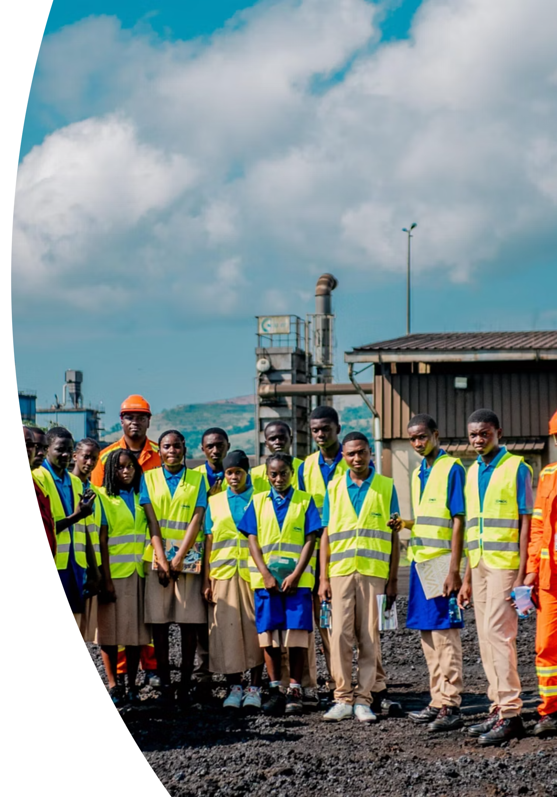
Mining Sector Opportunity: Gabon Market Entry Strategy
Strategic assessment for H.B. Fuller's entry into Gabon's rapidly expanding mining sector
Presented by: Rocky Mavie Adzaba Emvo

Slide 2


Executive Summary
Here are the key takeaways from our strategic assessment for H.B. Fuller's entry into Gabon's rapidly expanding mining sector:
Market Opportunity
Growth Trajectory
Entry Strategy
$1B+ addressable market in Gabon mining sector
25% CAGR projected through 2030
Pilot projects with 2 priority operators (Eramet Comilog, Nouvelle Gabon Mining)
Expected ROI
Timeline
20-30% downtime reduction = $50-100M annual value across target clients
First contracts within 6-9 months, full market penetration by Year 3

Slide 3




Why Now? The Window of Opportunity is Closing
MARKET TIMING
Gabon's mining sector is at inflection point (6% → 25% GDP by 2030)
$1B+ addressable market expanding NOW
Government actively seeking foreign investment partnerships
COMPETITIVE PRESSURE
International competitors already positioning in market (Q1-Q2 2025)
First-mover advantage critical for market share capture
Local players lack technical sophistication - our advantage window is 12-18 months
CLIENT READINESS
Eramet Comilog and Nouvelle Gabon Mining actively seeking solutions
Operational challenges creating urgent demand for efficiency improvements
Budget cycles align for Q1 2025 contract negotiations
Delay = Lost market share. Competitors are moving now. We must act immediately to establish presence and secure pilot contracts.

Slide 4
Overview
Strategic Opportunity in a High-Growth Market
Gabon's mining sector is experiencing unprecedented growth, positioned to become a cornerstone of the nation's economy. As the world's third-largest manganese producer, the country is rapidly expanding into iron ore, potash, and gold extraction.
7.5M
$1B+
Tonnes
Revenue
Manganese production in 2024, up 10.7% year-over-year
Manganese export value driving sector growth
With government backing and substantial foreign investment, the sector is projected to grow from 6% to 25% of GDP by 2030. This expansion creates significant demand for industrial solutions that enhance operational efficiency and ensure compliance.
25%
GDP Target
Projected mining contribution by 2030

Slide 5
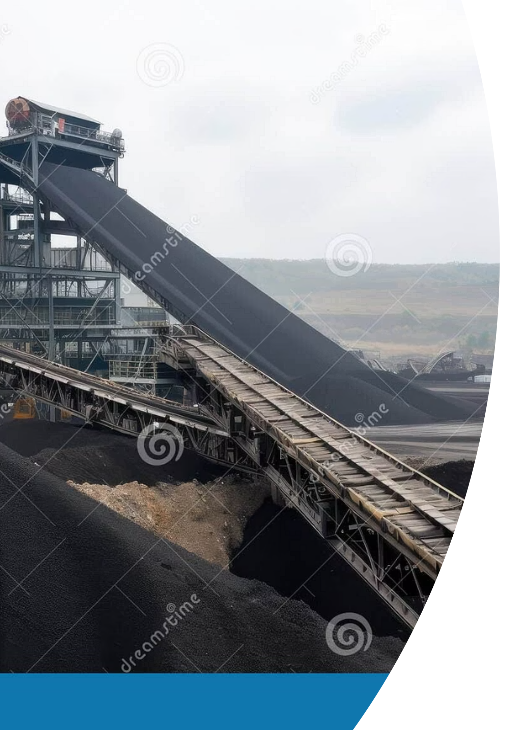
Market Landscape: Minerals & Production
Primary Focus
Growth Sectors
Manganese remains the dominant mineral, critical for steel production and emerging EV battery markets, establishing Gabon as a key global supplier.
Iron ore and potash projects are rapidly scaling, with major investments from international operators driving diversification.
Emerging Resources
Gold, copper, uranium, and bauxite present additional opportunities as exploration and development activities intensify.
Total mineral production reached 15.2 million tonnes in 2024, with Gabon ranking 64th globally. The government's strategic push for sector expansion creates a favorable environment for industrial solution providers.

Slide 6
Key Mining Operators
Strategic targets across large-scale operations and emerging projects
Company/Project
Mineral
Scale
Status
Eramet Comilog (Moanda)
Manganese
Large
Operational
Nouvelle Gabon Mining
Manganese
Large
Operational
Baniaka Iron Ore
Iron ore
Large
Development
Belinga Iron Ore
Iron ore
Large
Development
Banio Potash
Potash
Medium
Advancing
MOIL (India)
Manganese
Medium
Negotiations
Menar (South Africa)
Iron ore
Medium
Negotiations

Slide 7
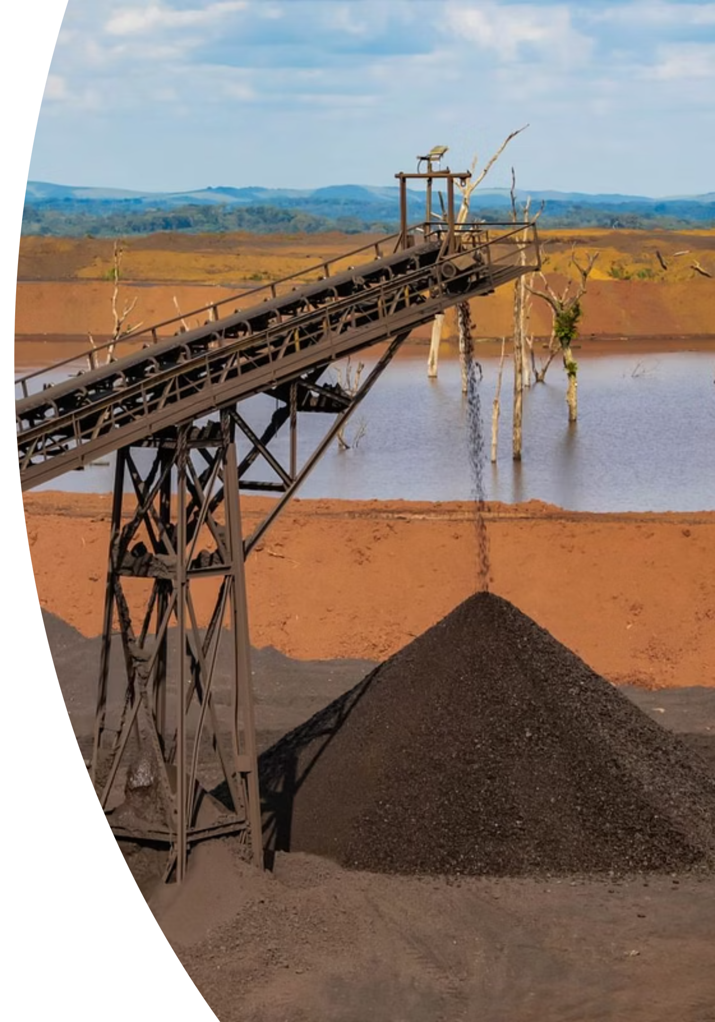
Critical Operational Challenges
Equipment & Maintenance
Heavy wear on machinery, conveyor belt failures, and pipeline leaks lead to costly downtime. Ore processing inefficiencies and frequent maintenance cycles strain operational budgets.
Infrastructure Limitations
Limited energy supply, inadequate railway capacity, and maintenance delays create bottlenecks. Off-grid operations drive up costs and complicate logistics.
Safety & Compliance
Elevated safety risks, particularly in small-scale operations. Robust regulatory framework exists, but inconsistent enforcement creates compliance challenges.
Environmental Pressures
Deforestation, soil degradation, and water pollution demand urgent attention. Companies face increasing pressure to meet environmental and local content regulations.

Slide 8

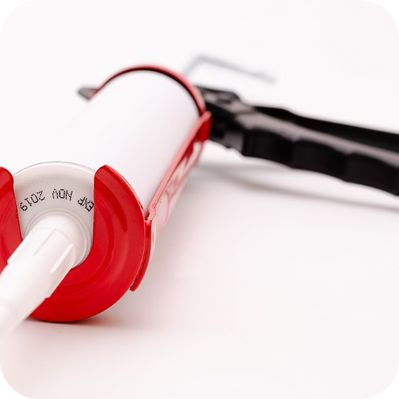
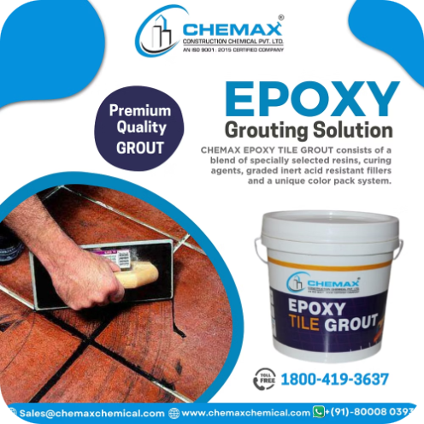
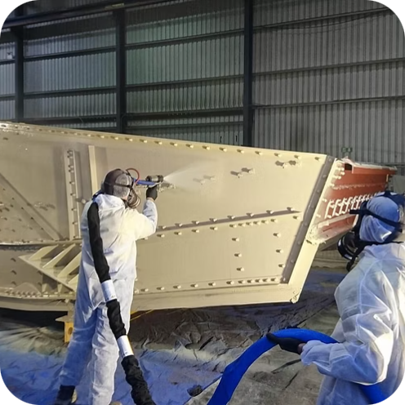
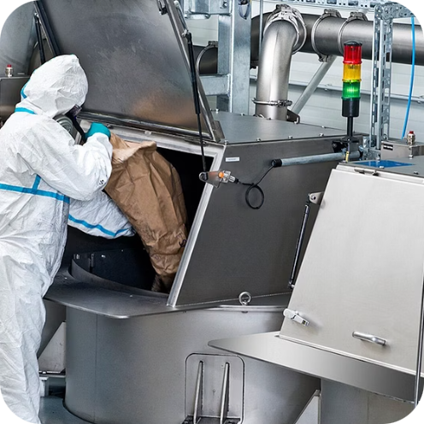
H.B. Fuller Solution Portfolio
Comprehensive industrial solutions addressing critical mining challenges
Industrial Adhesives
Sealants
Epoxies
Protective Coatings
Reduce downtime and extend asset life through advanced bonding solutions for equipment wear and conveyor belt repair.
Prevent leaks and improve safety with high-performance sealing solutions for pipelines and critical equipment.
Lower maintenance costs through structural repair and bonding solutions designed for extreme conditions.
Enhance compliance and reduce asset loss by protecting against corrosion and environmental exposure.
Specialty Chemicals
Improve efficiency and reduce waste in ore processing and equipment cleaning operations.

Slide 9
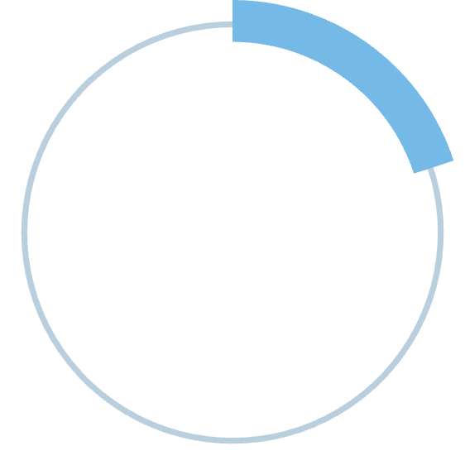
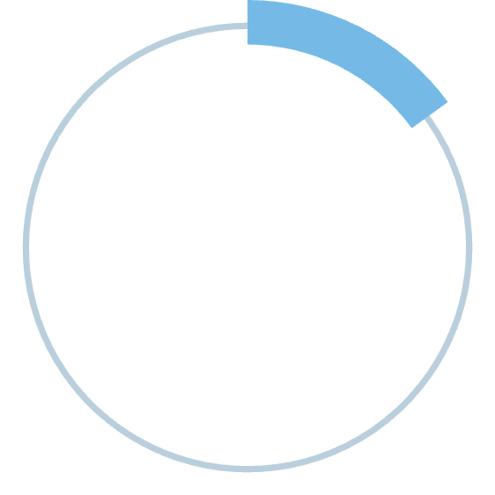
Measurable Client Value
H.B. Fuller solutions deliver quantifiable ROI through reduced operational costs, extended asset lifecycles, and improved safety compliance.
Our technical support includes tailored demonstrations, implementation consulting, and ongoing training to ensure optimal performance in demanding mining environments.
20-30%
15-25%
Downtime Reduction
Maintenance Savings
Minimize production losses through preventive maintenance
Lower recurring costs with durable solutions
20-40%
Asset Life Extension
Maximize equipment investment value

Slide 10



Target Client Segments
Large Mining Operators
Medium-Sized Operators
Service Providers
Priority targets: Eramet Comilog, Nouvelle Gabon Mining
Targets: Banio Potash, MOIL, Menar
Targets: Equipment suppliers, logistics, contractors
Decision-makers: Procurement, Maintenance Managers
Decision-makers: Procurement, Operations, Maintenance Directors
Decision-makers: Procurement, Operations Teams
Opportunity: Growing operations, expansion projects
Opportunity: High-volume contracts, strategic partnerships
Opportunity: Recurring supply agreements

Slide 11
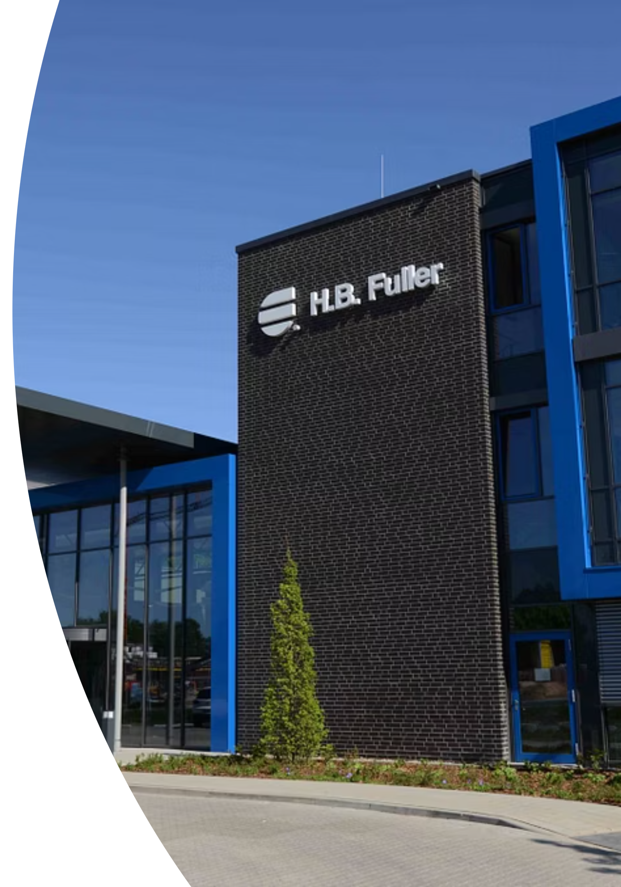
Competitive Differentiation
Market Competition
H.B. Fuller Advantages
Global expertise with local technical support capabilities
Local & Regional Players
Strengths: Local presence, competitive pricing
Customized solutions tailored to mining-specific challenges
Superior durability and performance in extreme conditions
International Competitors
Comprehensive training and implementation consulting
Strengths: Global scale, established reputation
Compliance support for environmental and safety standards

Slide 12
Strategic Roadmap for Market Entry
01
02
03
Targeted Outreach
Pilot Projects
Value Proposition
Engage procurement, operations, and maintenance leaders at priority mining operators. Leverage existing networks and industry connections.
Offer technical demonstrations and proof-of-concept trials. Focus on high-impact applications with measurable ROI.
Present ROI-focused proposals emphasizing downtime reduction, maintenance savings, and asset life extension.
04
05
Strategic Partnerships
Ongoing Support
Establish long-term supply agreements and preventive maintenance programs. Develop customized solution packages.
Provide continuous technical training, compliance consulting, and performance optimization to ensure client success.
Recommendation: Immediate action to secure pilot projects with Eramet Comilog and Nouvelle Gabon Mining will establish market presence and demonstrate competitive advantage in Gabon's high-growth mining sector.

Slide 13
Financial Projections & Implementation Requirements
Financial Projections (3-year outlook)
Implementation Requirements
Year 1
Initial Investment
$2-3M revenue (pilot phase, 2-3 contracts)
$500K-750K (team, local presence, certifications)
Year 2
Team
$8-12M revenue (market expansion, 8-10 contracts)
3-4 technical specialists + 1 regional manager
Year 3
Timeline
$20-30M revenue (full market penetration, 15-20 contracts)
6 months setup, 6-9 months first contracts
Key Success Factors
Local partnerships, technical certifications, customer training programs

Slide 14
Risk Assessment & Success Metrics
Risk Assessment
Success Metrics (KPIs)
Political/Regulatory Risk
Number of Active Contracts
Gabon has stable government, but monitor policy changes on foreign investment
Target 2-3 by Month 9, 15-20 by Year 3
Revenue per Contract
Competition Risk
Average $1-2M annually per major operator
Local players have cost advantage; mitigate with superior technical support
Customer Retention Rate
Supply Chain Risk
Target 90%+ (long-term partnerships)
Limited local supply chain; establish regional distribution hub
Market Share
Currency Risk
Capture 15-20% of addressable market by Year 3
CFA franc exposure; hedge through pricing mechanisms
Customer Satisfaction
NPS score 70+

Slide 15
Competitive Win Strategy
Competitor Comparison Table
Our Unfair Advantages
Technical Expertise
Superior & Mining-specific
Limited
Broad, less specialized
TECHNICAL SUPERIORITY
Mining-specific product formulations
Proven performance in extreme conditions
Proprietary application techniques
Local Presence
Strong & Integrated
Strong
Variable
HYBRID MODEL
Global scale + local presence
Customization
High & Tailored
Moderate
Limited
International standards + local partnerships
Cost-effective without sacrificing quality
Training Support
Comprehensive & On-site
Minimal
Basic
CUSTOMER SUCCESS FOCUS
Comprehensive training programs
Price Competitiveness
Value-driven & Cost-effective
Often lower initial
Higher
On-site technical support
Long-term partnership approach (vs. transactional competitors)
Speed to Market
Agile & Responsive
Agile
Slower

Slide 16
Path Forward: Immediate Actions Required
APPROVAL & FUNDING
(This Month)
MARKET ENTRY SETUP
(Months 1-3)
PILOT EXECUTION
(Months 4-9)
Approve $500K-750K initial investment
Establish regional office in Libreville, Gabon
Launch outreach to Eramet Comilog and Nouvelle Gabon Mining
Authorize team expansion (3-4 technical specialists + 1 regional manager)
Secure technical certifications and local partnerships
Execute technical demonstrations and proof-of-concept trials
Develop localized marketing materials and case studies
Decision needed: GO/NO-GO for market entry
Secure first 2-3 contracts and establish market presence
DECISION REQUIRED: Board approval needed by January 31, 2025 to meet Q1 2025 launch timeline and capture first-mover advantage. Delay beyond this date risks losing market position to competitors already in motion.
Expected ROI: $50-100M annual value by Year 3 | Investment: $500K-750K | Payback Period: 6-9 months
Presented by: Rocky Mavie Adzaba Emvo

